Slide 1

Visualizing Object
Detection Features
Computer Vision, Spring 2022
Yupei Zhou, Zhuoyuan Xu, Xinyi Gu

Slide 2
Outline
Motivation
Definition
Experiment Results
Single Inversion
Comparison with Other Methods
Parameter Tuning
Dictionary Size
Regularization
HOGgles: Visualizing Object Detection Features Yupei Zhou, Zhuoyuan Xu, Xinyi Gu

Slide 3
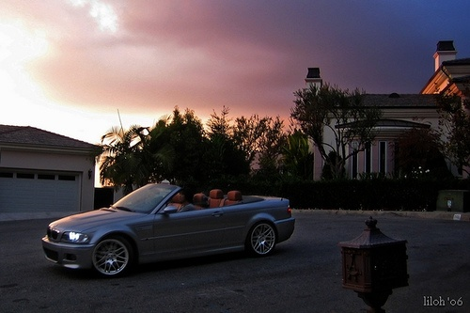
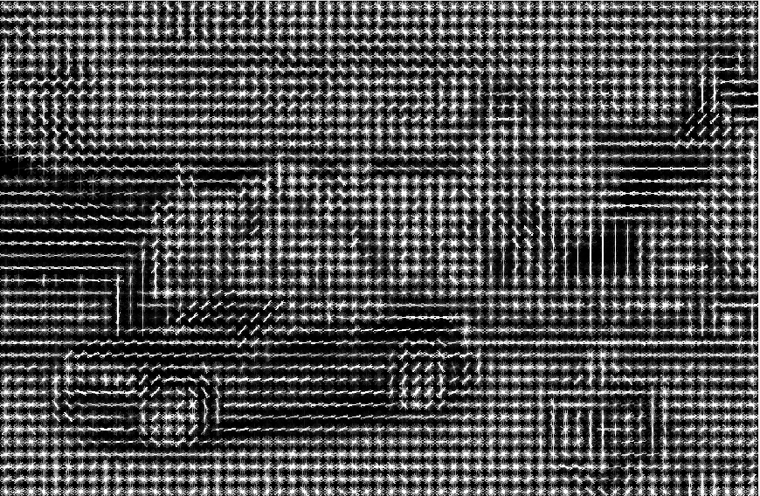
Motivation Definition Experiment Results Hyperparameter Tuning
Why do we want to filter images?
Why is image filtering important?
Why is visualization important?
Researchers can study the failures in the object detectors
HOG features are too high dimensional for humans to read
aeroplane
Original Image
HOG Descriptor
HOGgles: Visualizing Object Detection Features Yupei Zhou, Zhuoyuan Xu, Xinyi Gu

Slide 4
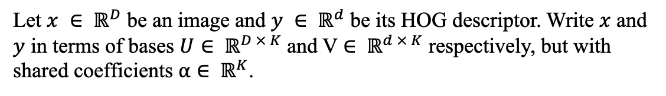
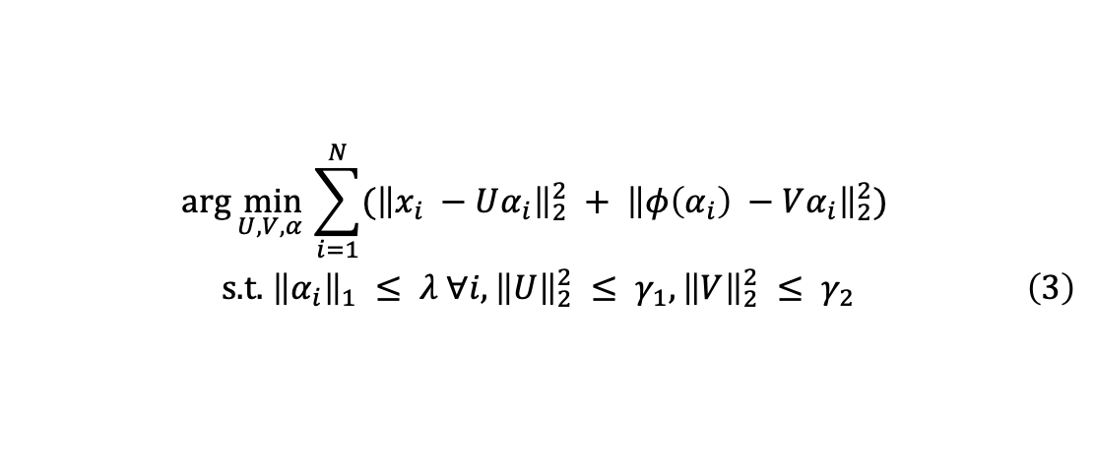
Motivation Definition Application Hyperparameter Tuning
Motivation Definition Application Hyperparameter Tuning
Motivation Definition Experiment Results Hyperparameter Tuning
Why do we want to filter images?
Definition of Paired Dictionary Learning
HOGgles: Visualizing Object Detection Features Yupei Zhou, Zhuoyuan Xu, Xinyi Gu

Slide 5
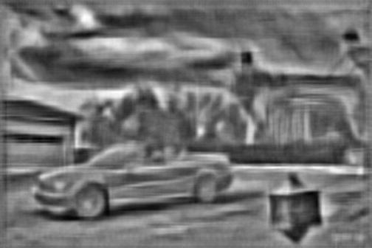
Motivation Definition Application Hyperparameter Tuning
Motivation Definition Application Hyperparameter Tuning
Motivation Definition Application Hyperparameter Tuning
Motivation Definition Application Hyperparameter Tuning
Motivation Definition Application Hyperparameter Tuning
Motivation Definition Experiment Results Hyperparameter Tuning
Single Inversion
aeroplane
Original Image
HOG Descriptor
Inversion
HOGgles: Visualizing Object Detection Features Yupei Zhou, Zhuoyuan Xu, Xinyi Gu

Slide 6
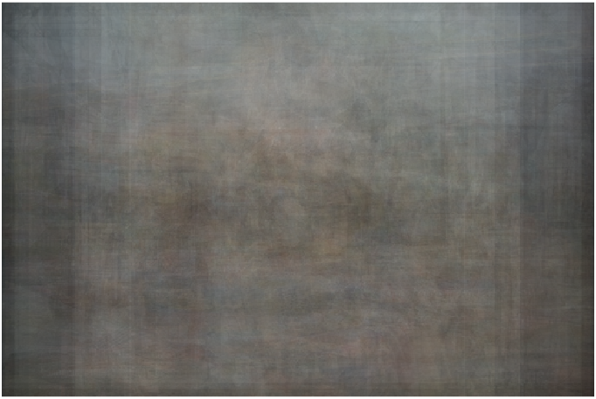
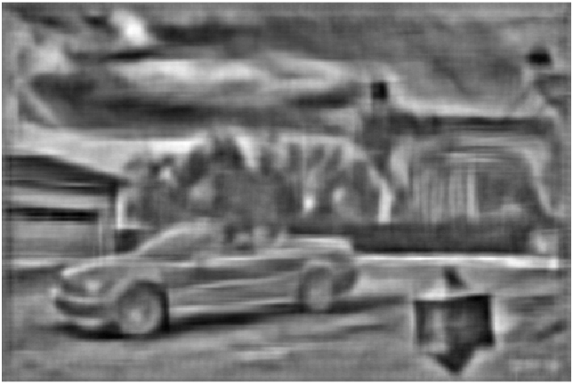
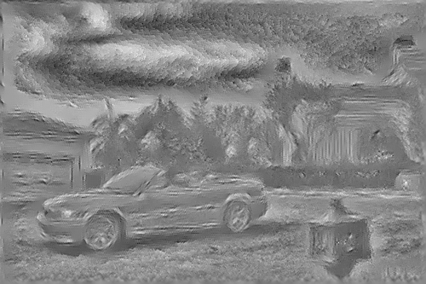
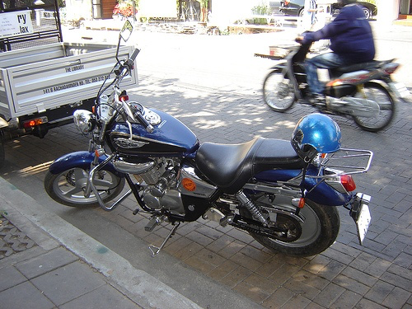
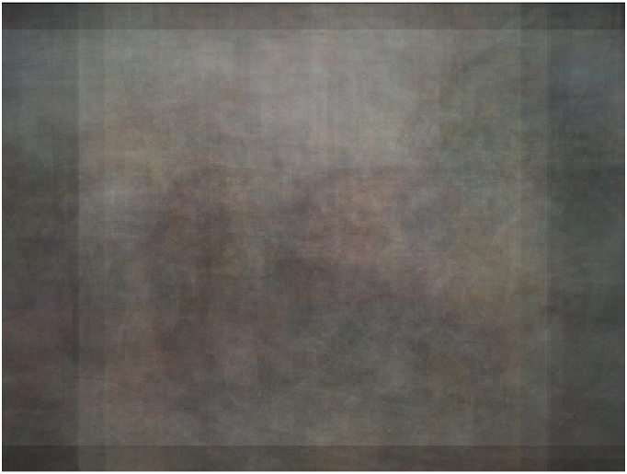
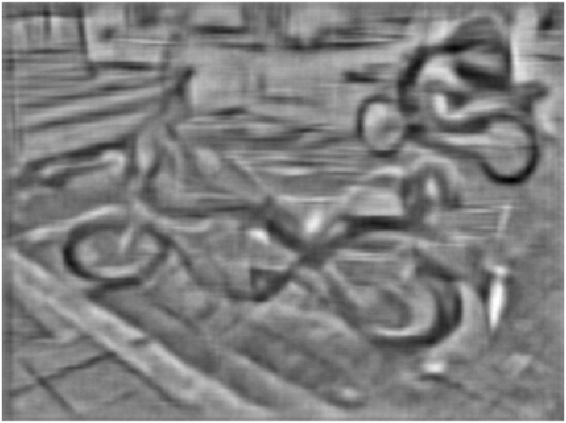
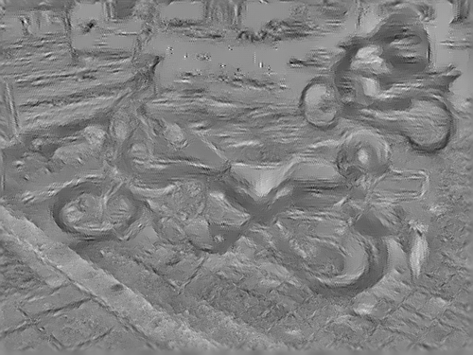
Motivation Definition Application Hyperparameter Tuning
Motivation Definition Application Hyperparameter Tuning
Motivation Definition Application Hyperparameter Tuning
Motivation Definition Application Hyperparameter Tuning
Motivation Definition Application Hyperparameter Tuning
Motivation Definition Application Hyperparameter Tuning
Motivation Definition Application Hyperparameter Tuning
Motivation Definition Application Hyperparameter Tuning
Motivation Definition Experiment Results Hyperparameter Tuning
Comparison with Other Methods
Original Image
ELDA
Paired Dict
CNN
HOGgles: Visualizing Object Detection Features Yupei Zhou, Zhuoyuan Xu, Xinyi Gu

Slide 7
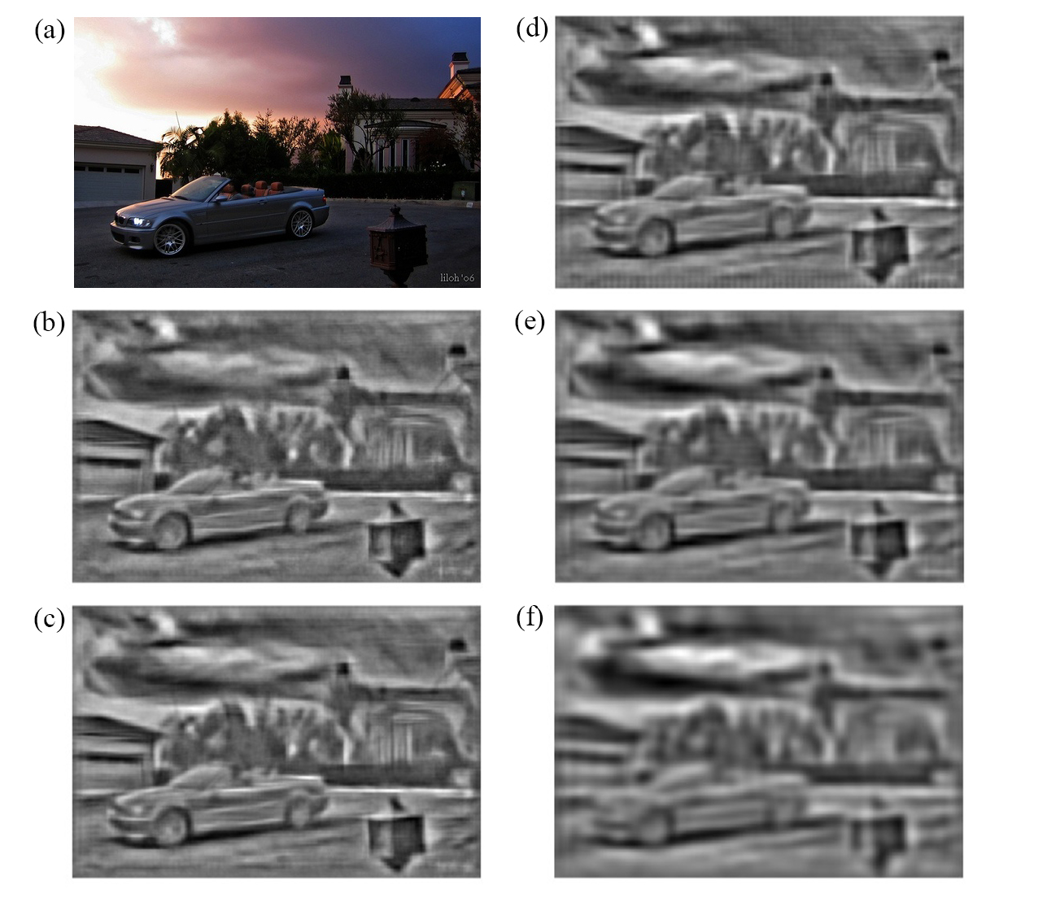
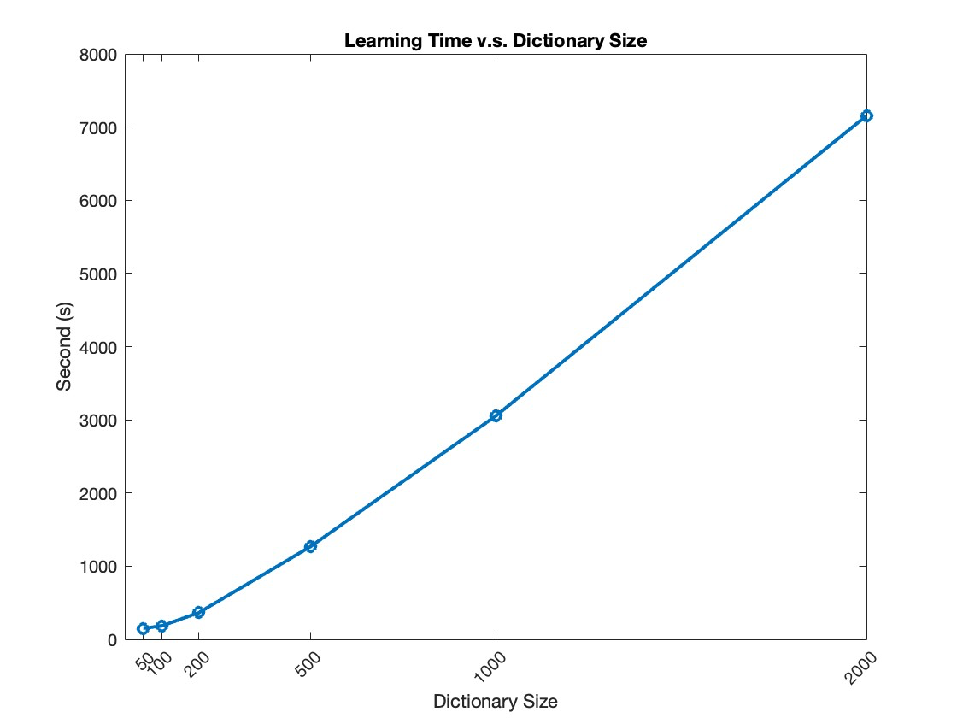
Motivation Definition Application Hyperparameter Tuning
Motivation Definition Application Hyperparameter Tuning
Motivation Definition Application Hyperparameter Tuning
Motivation Definition Application Hyperparameter Tuning
Motivation Definition Application Hyperparameter Tuning
Motivation Definition Application Hyperparameter Tuning
Motivation Definition Application Hyperparameter Tuning
Motivation Definition Application Hyperparameter Tuning
Motivation Definition Application Hyperparameter Tuning
Motivation Definition Experiment Results Hyperparameter Tuning
Hyperparameter Tuning (Dictionary Size)
Feature inversion visualization with different dictionary sizes. (a) original image; (b) size=2000; (c) size=1000; (d) size=500; (e) size=200; (f) size=50
HOGgles: Visualizing Object Detection Features Yupei Zhou, Zhuoyuan Xu, Xinyi Gu

Slide 8
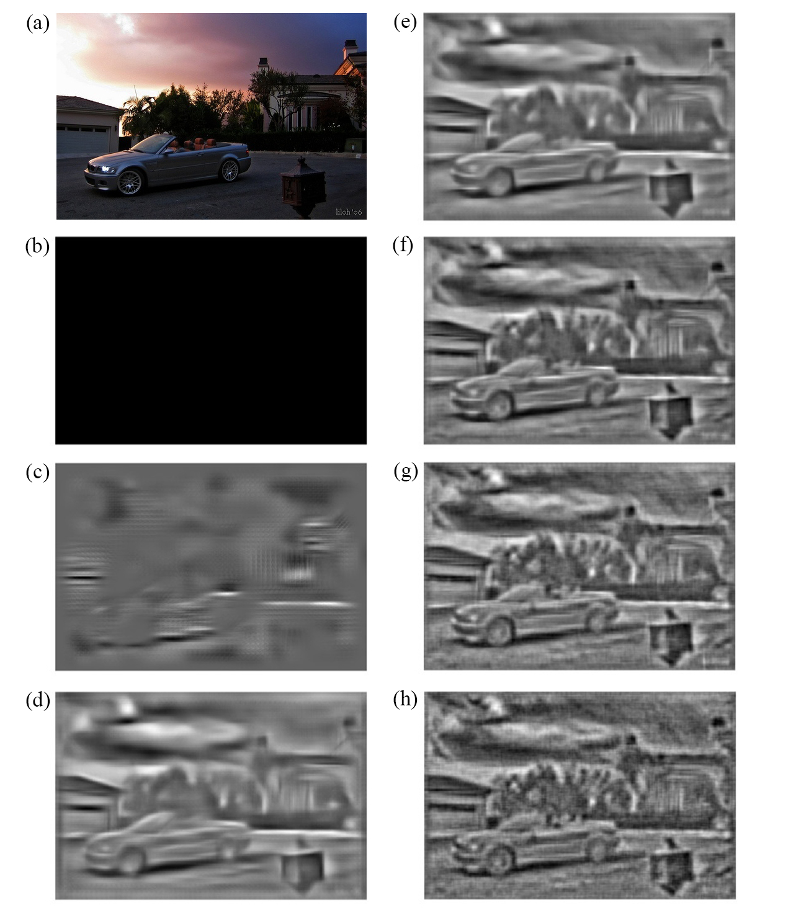
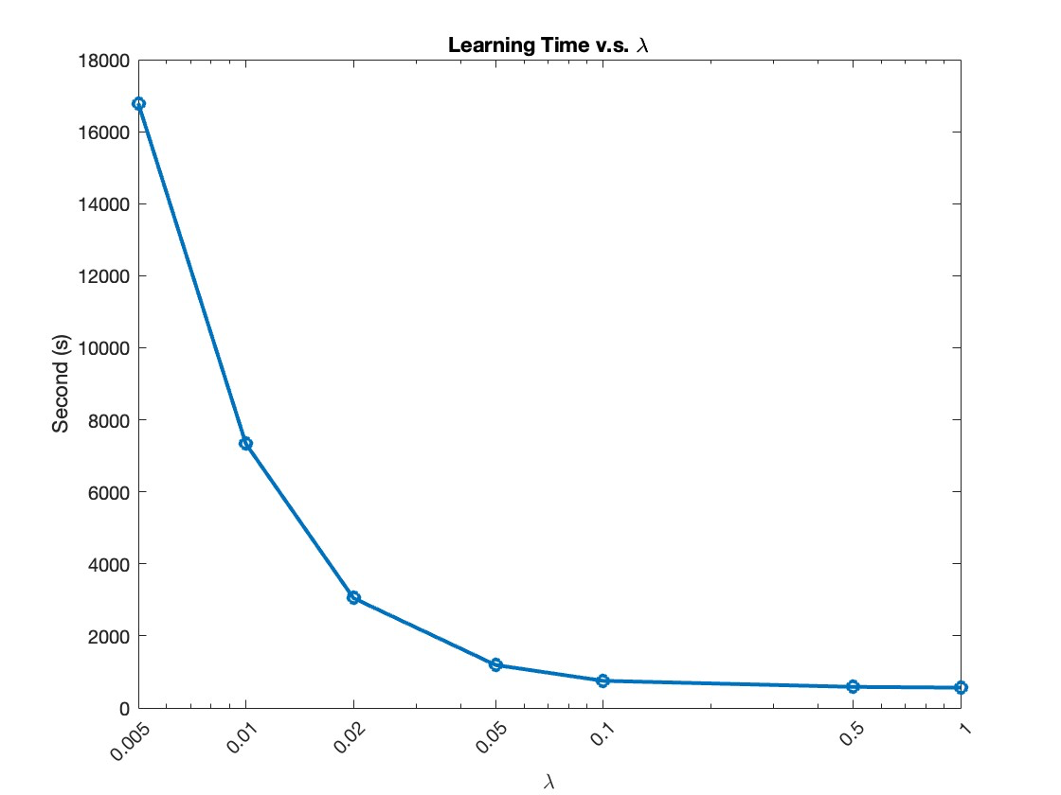
Motivation Definition Application Hyperparameter Tuning
Motivation Definition Application Hyperparameter Tuning
Motivation Definition Application Hyperparameter Tuning
Motivation Definition Application Hyperparameter Tuning
Motivation Definition Application Hyperparameter Tuning
Motivation Definition Application Hyperparameter Tuning
Motivation Definition Application Hyperparameter Tuning
Motivation Definition Application Hyperparameter Tuning
Motivation Definition Application Hyperparameter Tuning
Motivation Definition Application Hyperparameter Tuning
Motivation Definition Application Hyperparameter Tuning
Motivation Definition Application Hyperparameter Tuning
Motivation Definition Application Hyperparameter Tuning
Motivation Definition Experiment Results Hyperparameter Tuning
Hyperparameter Tuning (Regularization λ)
Feature inversion visualization with different regularization λ values. (a) original image; (b) λ=1; (c) λ=0.5; (d) λ=0.1; (e) λ=0.05; (f) λ=0.02; (g) λ=0.01; (h) λ=0.005
HOGgles: Visualizing Object Detection Features Yupei Zhou, Zhuoyuan Xu, Xinyi Gu

Slide 9
Motivation Definition Application Hyperparameter Tuning
Motivation Definition Application Hyperparameter Tuning
Motivation Definition Application Hyperparameter Tuning
Motivation Definition Application Hyperparameter Tuning
Motivation Definition Application Hyperparameter Tuning
Motivation Definition Application Hyperparameter Tuning
Motivation Definition Application Hyperparameter Tuning
Motivation Definition Application Hyperparameter Tuning
Motivation Definition Application Hyperparameter Tuning
Motivation Definition Application Hyperparameter Tuning
Motivation Definition Application Hyperparameter Tuning
Motivation Definition Application Hyperparameter Tuning
Motivation Definition Application Hyperparameter Tuning
Motivation Definition Application Hyperparameter Tuning
Motivation Definition Experiment Results Hyperparameter Tuning
Why do we want to filter images?
Why is image filtering important?
Reference
[1] Everingham M, Van Gool L, Williams CKI, Winn J, Zisserman A (2010) The pascal visual object classes challenge. IJCV 6, 9
[2] Hariharan, B., Malik, J., Ramanan, D. (2012). Discriminative Decorrelation for Clustering and Classification. In: Fitzgibbon, A., Lazebnik, S., Perona, P., Sato, Y., Schmid, C. (eds) Computer Vision – ECCV 2012. ECCV 2012. Lecture Notes in Computer Science, vol 7575. Springer, Berlin, Heidelberg. https://doi.org/10.1007/978-3-642-33765-9_33
[3] D. Hoiem, Y. Chodpathumwan, and Q. Dai. Diagnosing error in object detectors. In ECCV, 2012.
[4] A. Mahendran and A. Vedaldi, "Understanding deep image representations by inverting them," 2015 IEEE Conference on Computer Vision and Pattern Recognition (CVPR), 2015, pp. 5188-5196, doi: 10.1109/CVPR.2015.7299155.
[5] C. Vondrick, A. Khosla, T. Malisiewicz, and A. Torralba. Hoggles: Visualizing object detection features. ICCV, 2013. 2, 3, 4
[6] J. Yang, J. Wright, T. Huang, and Y. Ma. Image super-resolution via sparse representation. Transactions on Image Processing, 2010.
HOGgles: Visualizing Object Detection Features Yupei Zhou, Zhuoyuan Xu, Xinyi Gu

